Slide 1
Group 98
Joseph Rutigliani

Slide 2
(Overview)Generating the Data
I used online random name generators to generate all names found
I then programmed random number generators to find all numbers found
I then randomly assigned names to numbers
After that point, I enforced the pattern constraints which deleted all “bad” data, keeping only the data that followed the patterns

Slide 3
(Overview)After Generating The Data
I decided to use PHP, HTML and JavaScript(Jquery) for this project. I found this tremendously easier than what was suggested on Sakai.
I came across this YouTube Tutorial : https://www.youtube.com/watch?v=yAmXgDKu2go&list=PLhPyEFL5u-i0zEaDF0IPLYvm8zOKnz70r which explained how to set everything up
This was all done from localhost
To style the page, I used CSS

Slide 4
(Overview)Awardspace
After completing all my front end work on localhost, I had to upload it to a webhost
Thanks to PHPMyAdmin, I was able download my entire database as an insert SQL query, making it easy to upload anywhere
After more Googling, I came across the Awardspace webhost where I paid to host my server

Slide 5
Drinker Page
I decided to display a table, showing ALL of the selected Drinker’s transactions, ordered by their transaction ID (Time)
I then displayed 2 bar graphs, one which grouped all the bars together, showing how much was spent in the bar by a drinker.
The other displayed how many beers the drinker purchased, regardless of the bar

Slide 6
Bar Page
I displayed 5 bar graphs in total on this page
The first one displayed the top spenders for the selected bar
The second displayed the top beer manufactures sold for the selected bar
The third displayed the top beers sold for the selected bar
The fourth displayed the busiest days of the week for the selected bar
The Final displayed the busiest hours of the day for the selected bar

Slide 7
Beer Page
I displayed 4 bar graphs in total on this page
The first displayed which bar sold the most of the selected beer
The second displayed drinkers who consumed most of the selected beer
The third displayed the day of the week when the most of the selected beer was consumed
The final displayed the hours of the day where the selected beer is most consumed

Slide 8
Modifications/Sql Interface
This page is very unique
I have 2 different drop down menus
One of which is where you can select a table you’d wish to insert to
After selecting the table from the dropdown menu, you will be prompted with a form
Each row of the form has an attribute name from the table
You then type in each form what you’d like to be inserted into that column for the database
The second dropdown menu does that same thing, but it is for deletion

Slide 9
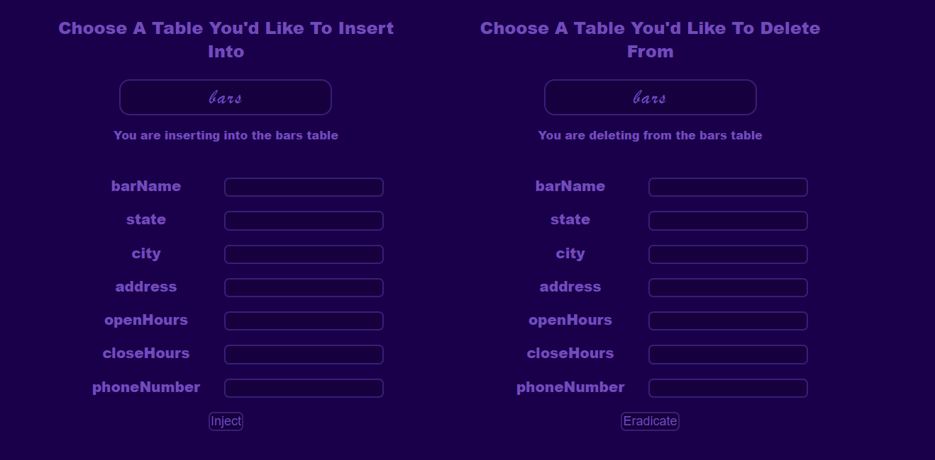
Example – Inserting into / Deleting from bars, and forms for the attributes

Slide 10
Modifications/Sql Interface (Cont..)
Next, we have the Sql interface – which you can perform modifications from as well!
You are faced with a text area box in which you can evaluate queries
Pretend you are writing queries into MySQL
Both, the dropdowns as well as the SQL query box have checks, you may delete, insert, update, etc using the query box and will not perform the action if any constraints are violated

Slide 11
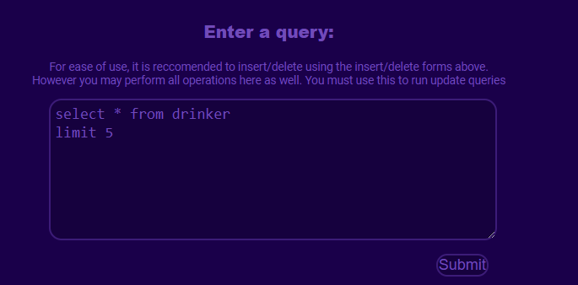
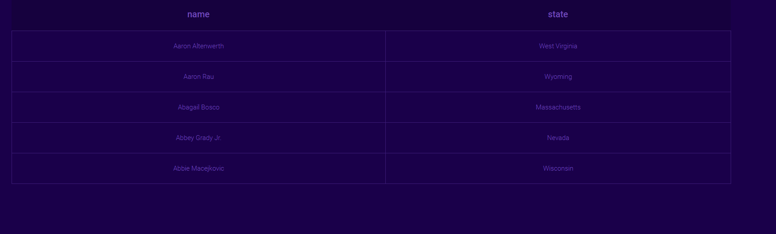
Example

Slide 12
Conclusion
Overall, this is a full stack, interactive web application which coherently and effectively displays user generated data given pattern constraints
In addition, this web application allows end users to modify the data in anyway they please, given all constraints are followed
Thank you for watching, and have a nice day

